Slide 1
Winning the Presidency

Slide 2
Stage 1: Winning the Nomination

Slide 3
When should I start campaigning? Why?
Soon after the previous presidential election to raise the money and assemble an organization as soon as possible.

Slide 4
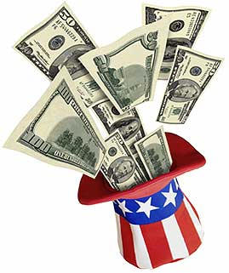
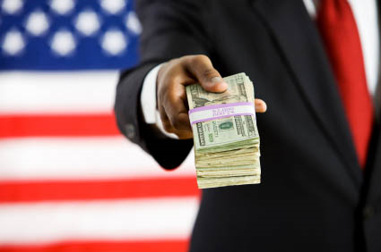
Can I get money from the government during this stage?
Yes, but you have to agree to remain within spending limitations.

Slide 5
What actually happens at the presidential primaries?
Presidential primaries have two features
“Beauty contest” or popularity vote
Voters indicate which candidate they prefer but do not actually elect delegates to the convention
Actual voting
Assigning delegates to a candidate.

Slide 6
How many state presidential primaries & caucuses do I have to win in order to make it to the next stage?
You need to win the majority vote of the delegates—both normal delegates (chosen by voters to back a specific candidate) and super delegates (notable figures in the party such as former presidents, state governors and members of the two houses of Congress who are free to back whichever candidate they wish).
In the election of 2008, Democrats had a total of 4,049 delegates including super delegates and so, to win the nomination, the Democratic front runner needed a total of 2,025 delegates.

Slide 7
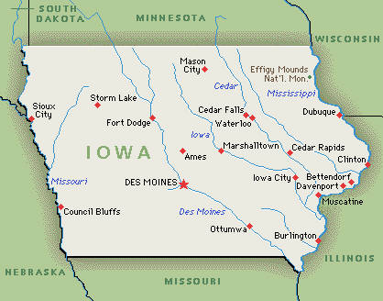
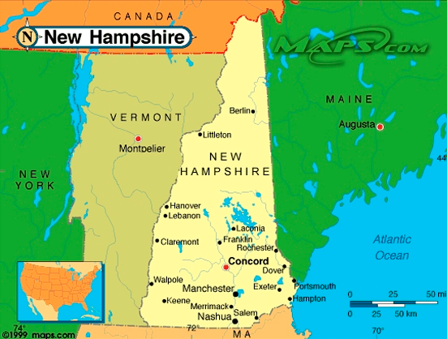
Why focus heavily on winning the Iowa and New Hampshire primaries? Can’t I just focus on winning the states with the larger electoral votes?
Iowa holds the first caucus, and New Hampshire holds the first Primary
most advantageous for nominees to win these states
earliest competitions
determines the popular candidates
the bandwagon effect may help in gathering more followers.

Slide 8
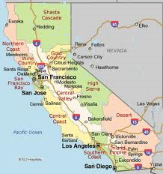
I didn’t win the New Hampshire primary election! Is it over for me?
Although New Hampshire can be a valuable asset in gaining momentum, this does not mean that all other 49 states are now lost. In fact, our nominee has influence over the two biggest states with the most electoral votes.

Slide 9
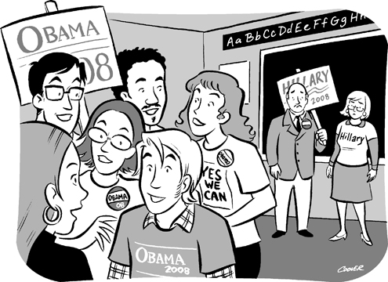
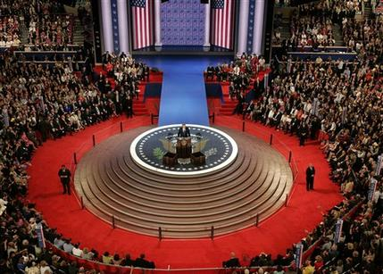
I don’t get the difference between a caucus and a convention.
Caucus - closed meeting of local party members to choose party officials or candidates for public office.
Convention - meeting of delegates or representatives; the common issues are often limited to selecting a party candidate or party chairman.

Slide 10
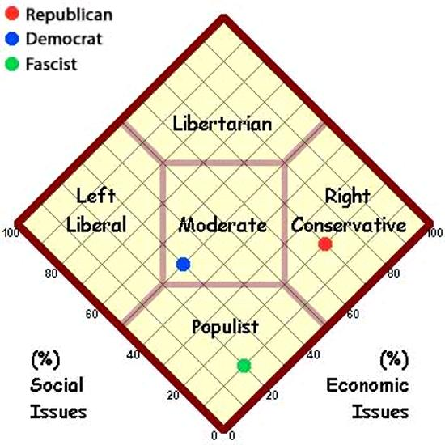
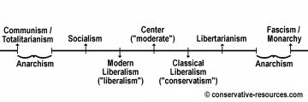
Given the political party I am affiliated with, what groups do I have to appeal to? What do I need to do to win the general election?
Democratic hopefuls have to appeal to the liberal wing of their party as well as to minorities, union members, and environmental activists. But to win the general election, candidates have to win support from moderates and pragmatic voters, many of whom do not vote in the primaries.

Slide 11
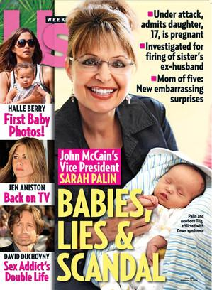
Do you think the media can help/hurt me in this stage of the campaign?
The ability of candidates to generate momentum by managing the media’s expectations of their performance is very important.

Slide 12
Stage 2: Campaigning at the Convention

Slide 13
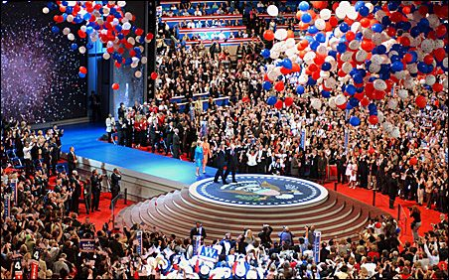
Today, the national party convention is no longer exciting because everyone knows who won the nomination. What’s the point of going?
Conventions are major media events.
Recently, instead of covering the conventions from the beginning of the first night to the end of the fourth night, major networks only give parties a limited time to feature their most important speakers and highlight their most important messages.
In 2004, viewership of the conventions increased slightly after a long-term decline in viewership leading to the reduced hours of coverage.

Slide 14
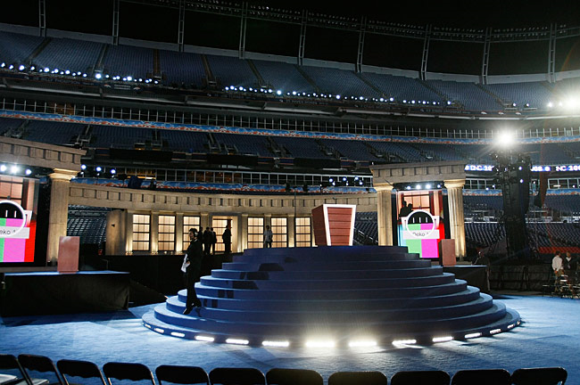
Can you write my acceptance speech for me?
Your acceptance speech provides you with an opportunity to define yourself and your candidacy.
It is better if you wrote the speech, but we can advise you on your content to avoid catastrophes like Barry Goldwater’s speech to the Republicans convention in 1964 when he said, “extremism in the defense of liberty is no vice,” which helped to define himself as “dangerous” and “extreme.” His opponent, Lynden Johnson, exploited these themes.

Slide 15
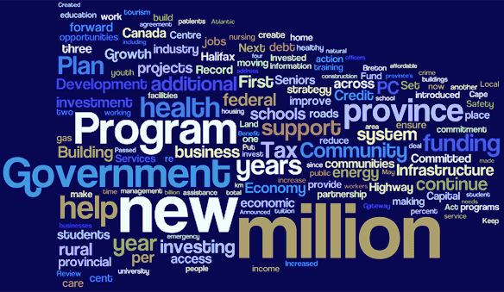
Why write a party platform if it might hurt me in my campaign?
The party platform defines the direction a party wants to take.
Despite the charge that the platform is ignored, most presidents try to implement much of it. For example, when President George W. Bush signed an education bill into law, he pointed to his party’s commitment to “leave no child behind.”

Slide 16
When should I announce whom I’ve chosen for my Vice-President?
You may choose at the convention, but it is not advised to do so since it is not a time conductive to careful and deliberate thought.
Usually the choice is made before the convention, and the announcement is timed to enhance media coverage and momentum going into the convention.
The last time a presidential candidate left the choice of VP to the delegates happened at the Democratic convention in 1956.

Slide 17
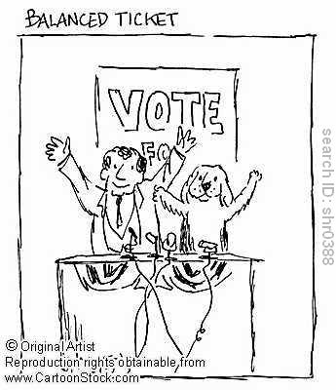
What type of a person should I choose to be my Vice-President?
Traditionally, presidential nominees choose running mates who will “balance the ticket.” Choose someone who has qualities that you lack. Democratic presidential nominee Walter Mondale raised this tradition to a dramatic new height in 1984 by selecting a woman, NY Representative Geraldine A. Ferraro, to run with him. His bold decision was an effort to strengthen his appeal to women voters.
You also have the option to ignore the idea of a balanced ticket, as George W. Bush did when he chose Richard Cheney, another Texan from the oil industry, to be his running mate.

Slide 18
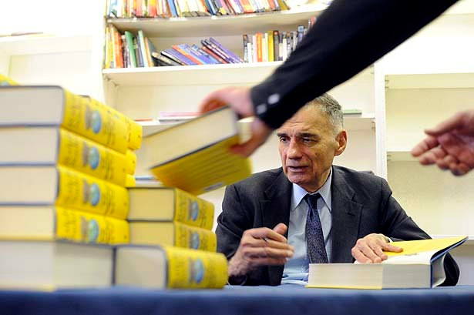
Can I run for president without going through the laborious process of primary elections and conventions?
Yes, if you are rich enough or well-known enough.
In 2004, the petition process was as simple as submitting the signatures of 1000 registered voters in Washington State, or by paying $500 in Colorado or Louisiana, or as difficult as getting the signatures of currently registered voters equal to 2% of total votes cast in the last election in North Carolina. Independent candidate Ralph Nader made the ballot in 34 states and the District of Columbia. He was excluded from 16 states, including Ohio and Pennsylvania.

Slide 19
Stage 3: Mobilizing Support in the General Election

Slide 20
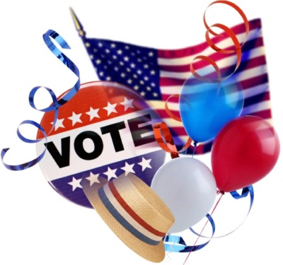
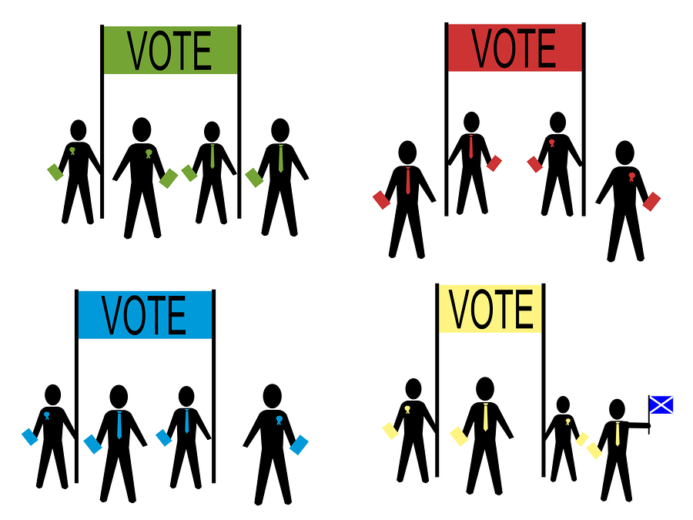
Whew, could I rest for a bit since I just won the nomination?
Sorry, but no. Although candidates have traditionally been able to recover for a few weeks from the fight for nomination, recent elections have changed this tradition. Campaigning is now more critical than ever, so prepare to be aggressive.

Slide 21
Do I have to do a televised debate?
Televised debates are a huge part of presidential elections and can boost your campaign efforts
You are allowed to propose alternative formats, locations, and dates of the debate. However, it is viewed negatively if you appear to be avoiding the debate.

Slide 22
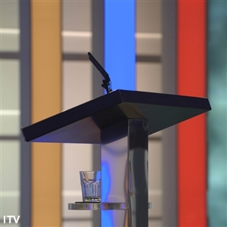
What can I do to do well on televised debates?
Do your best to respond to questions quickly and accurately.
Remember to relax. As long as you don’t make any major mistakes, you should benefit from the debate.
The audience will be able to learn more about your stance on various topics and what makes you different from your opponent.

Slide 23
Should I push to include third parties in the televised debates? Why?
No, because it could
Take time off from you and the other party’s debate time
Reduce likelihood of both major parties’ candidates’ participating.

Slide 24
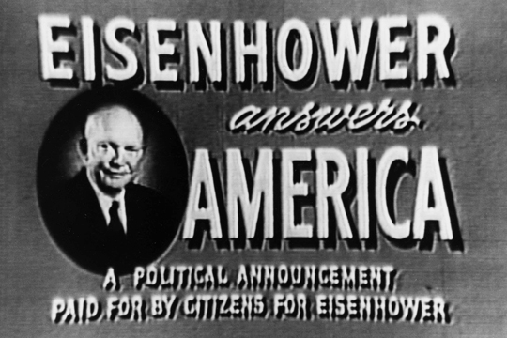
How can I manipulate the media to help me get elected to the general election?
You can run commercials to specific kinds of people.
For example:
People who watch a station that supports your ideas.

Slide 25
Most voters vote on the basis of what two things? How does this relate to me?
Most voters vote on the basis of:
Candidate Appeal
Party Appeal
You have to portray a positive image towards yourself and your party

Slide 26
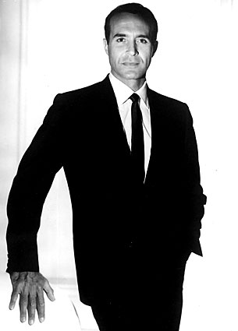
New President elect
Special thanks to campaign managers: William Chung, Kristi Hammond, Isabella Leung, Mio Rikitake, Clarabelle Santos, and AJ Sholing

